Slide 1


The 4 Steps To A
Discipleship Training Movement
In The Developing World
By John Edmiston
CEO, Cybermissions

Slide 2
The 4 Steps
Create – high-quality resources in digital formats
Deliver – the resources to the devices people actually own
Train – facilitators in how to use the resources and devices
Catalyze – a disciple-making movement in a community

Slide 3
Step 1- CREATE
Create a wide range of resources that are excellent, clear, and structured and which keep people biblical, honest and theologically balanced.
Curate the resources for cultural relevance, age relevance and situational relevance.
Check that the resource is in a digital format that people can access on their devices. Safe formats include MP3, html, text and PDF. Video may be difficult in some low-bandwidth areas.

Slide 4
Step 2 - DELIVER
Deliver the resource to the device that most people own or have direct access to.
Mobile phones, TVs, radios, tablets, and Internet cafes are among the most common and accessible means of delivery.
Delivery methods include wireless hotspots, SD cards, BlueTooth, Internet downloads, apps, hard drives full of resources, Internet radio, websites and so on, see http://cybermissions.org/mobilemin/

Slide 5
Step 3 - TRAIN
Information tends not to work very well on its own! You will need teachers, trainers and facilitators.
You need to train your trainers in four things:
a) The content that you have created
b) The delivery method and how to use it
c) How to facilitate a small group well
d) How to recruit group members
The best facilitators are also able to depend on God for their finances or to do business-as-mission.

Slide 6
Step 4 - Catalyze
Once you start seeing success and have something you can “show off” to others, that is the time to catalyze a discipleship training movement.
Organize conferences, consultations, and also engage in focused project collaboration with other churches and mission agencies. Global events in many locations.
Think multiplication not addition
Share a clear vision of transformation and a simple pathway for achieving it, along with stories of success.
Build trust first, then tackle projects together!

Slide 7
Good Examples
Harvestime – Immediate Bible Institute
Perspectives Course – from the US Center for World Mission
T4T – 6 week discipleship process
ISOM – video school of ministry
IHOP – International House of Prayer
The “Simple Church” movement
The various urban poor, New Friars movements
These all more-or-less followed the 4 steps of:
Create, Deliver, Train, Catalyze – modifying the resources and delivery methods over time in response to new ideas and circumstances.

Slide 8
The Main Challenges
Must cost the student less than $30 per month
Delivery must work in low-bandwidth areas
Must not require expensive buildings or libraries
Must use their devices, ones they already own, not expensive imported Western devices.
No copyright restrictions (Creative Commons resources)
BYOD (bring your own device) world means that we need to use device independent formats e.g, Text, PDF, html and MP3 audio.
Program should become self-supporting and self-multiplying

Slide 9
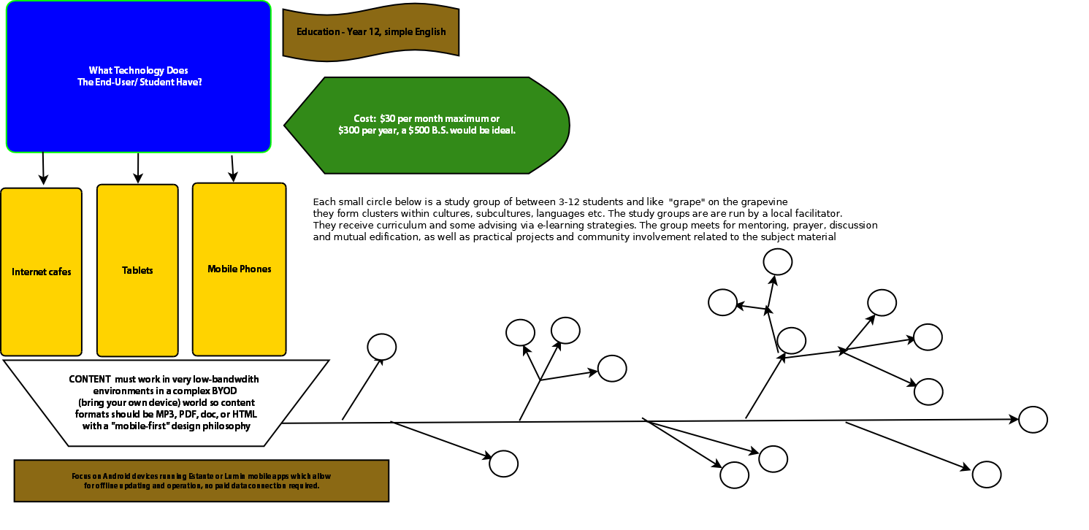
How The Process Works

Slide 10
Clarifying Concepts
Information is Digital - resources & delivery
Impartation Is Spiritual - prayer, healing etc.
Formation Is Personal - small groups, one-on-one
Transformation Is Communal - church & community

Slide 11
A Complete Package
A discipleship movement needs ALL of the above key concepts!!
Not just excellent information, but also spiritual impartation, personal spiritual formation and a community aiming at transformation of themselves and their local community.
However, information is the start of the process. Proclaiming and teaching are the foundations for discipleship and the Great Commission.

Slide 12
Oral Learners
Up to 70% of people do not enjoy large amounts of reading or writing.
However, they do enjoy learning via video and audio.
Creation of good video is getting easier, but is still challenging. Powerpoint can sometimes substitute.
Discussing a Bible story, the characters and circumstances can be a powerful means of discipleship.
A simple “write in the blanks” workbook with minimal text can help oral learners to record their thoughts.

Slide 13
Internet Radio
Internet radio is just a digital delivery mechanism for high-quality audio content, often in MP3 format.
The radio station is on the Internet – as a website or mobile app.
Internet radio and MP3 podcasts can be streamed live or set as download.
The MP3 files can be very short and targeted. They can also be longer such as sermons, lectures or entire audio-Bibles.
There are many different technical options for setting up an Internet radio. Icecast is one good option if you own a server.
The audio-based training materials can then be saved to a user’s device, such as an SD card, computer, or a mobile phone.
Once the person has the MP3 file they can listen at home, while stuck in traffic, or while doing other work.
The audio files can be arranged into a training curriculum.

Slide 14
Audio Learning Groups
The MP3 based training (e.g. audio bible, sermon, lecture, or story) is played to the group by the facilitator.
The group takes notes.
The group then discusses the training material.
The facilitator draws out the group with good questions.
The group goes deeper into the story or Bible passage.
The group applies the learning to a scenario or to a real-life situation.

Slide 15
Flipped Learning / TEE see www.flippedlearning.org
The concepts are initially presented online (video, audio, text etc) and the individual student goes through it at his/her own pace.
Later the training concepts are then explored in depth by the instructor and the group.
TEE was begun in Guatemala in 1963 where it was known as TEE or Theological Education by Extension. Here is an example in Bangladesh

Slide 16
Mentoring / Personal Discipleship
Many groups such as Navigators, Campus Crusade and Equipping the Saints have promoted 1:1 personal or small group discipleship.
Others such as MentorLink have promoted formal mentoring along with the informal mentoring in business groups such as Full Gospel Businessmen’s Fellowship.
Historically “spiritual directors” have assisted with the spiritual growth of Christians seeking a deeper walk with God.
Some kind of personal mentor, prayer partner or accountability group is part of the personal formation part of discipleship. If disciples then make more disciples, this can grow exponentially into a discipleship movement within a certain area (such as a university)

Slide 17
Learning Community Tensions
Emotional safety vs. spiritual adventure
Clear basic doctrines vs. room to experiment and discover new things about God
Clear and definite leadership vs. being without compulsion, exercising Christian freedom.
Sense of history, common purpose and tradition vs. openness to new methods & new territory, adaptable
Know they are part of the solution vs. humbly dependent on God.
Homogeneous and united leadership vs. great diversity in membership
God has brought this community into being vs. the drive to add more to the community
Not focused on money vs. true abundance, care of the poor.

Slide 18
Transformational Experiences
Jesus stretched his disciples through transformational, paradigm-shifting, spiritual experiences in community.
Action – Reflection – Action: enter into the experience, reflect on the experience, change one’s lifestyle and actions as a result.
We see this with the MATUL students living in slum communities; massive change in worldview.
Need to deliberately construct such experiences as part of disciple-making movements. Not just recklessly deep-ending individuals. Need to be as a group, communal, and with proper debriefing and deep theological reflection.

Slide 19
Collected Wisdom
Over time, the disciple-making community gains wisdom, insights, best practices, “how-to” methods such as tips-and-tricks, experiences and case studies that are incredibly valuable.
These can be collected digitally as videos, stories, entries in a blog or wiki, an online diary or spiritual journey, podcasts, ebook series, or more systematically into an archive or Wikipedia format.
They can also be used to improve the training. Step -1 CREATE is always dynamic. It can always be tweaked and improved as new things are learned and as needs change.
Writers, biographers, videographers, archivists and collectors of stories should be encouraged to emerge within the disciple-making community.

Slide 20
“Apostolic” Oversight
As the disciple-making movement spreads, there needs to be city-level and national level senior leaders who form the core of the movement. These leaders will often have post-graduate degrees and deep life experience.
These senior leaders (“apostles”) then network with each other as well as with the movement as a whole, keeping it in balance. They will also include voices of values and conscience (“prophets”) as well as those sensitive to the leading of the Holy Spirit (“seers”), though I do not recommend using these terms as titles or offices because they are just confusing.
They are especially important in training new leaders as well as solving key issues regarding the training content and delivery methods.
They are the key people in catalyzing the discipleship movement.

